Slide 1
our school
and country

Slide 2
The building of High School in Nisko is a beautiful point of the town. It’s located in the town centre.

Slide 3
THE history of high school in nisko
At the beginning of the 20th century there was no high school in Nisko. Our school, founded in 1912, was the first one.
In 1935 it was named in honour of Stefan Czarniecki - a military commander, regarded as a Polish national hero.
In 1944 the first Matura exam (most important school exam) in post-war Poland took place on the school premises.

Slide 4
in our school we celebrate:

Slide 5
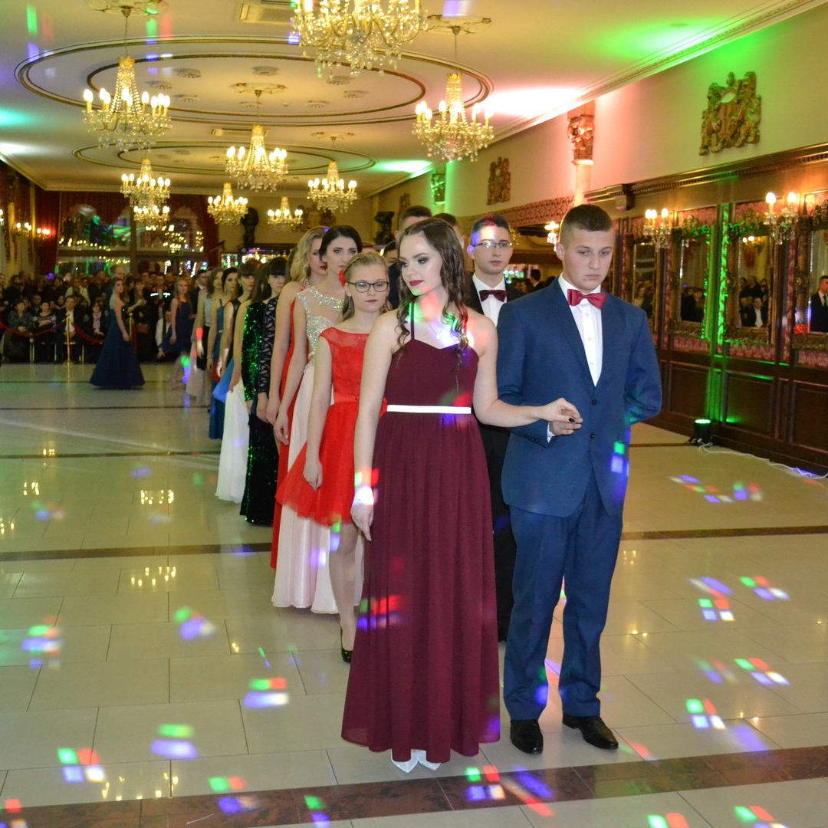
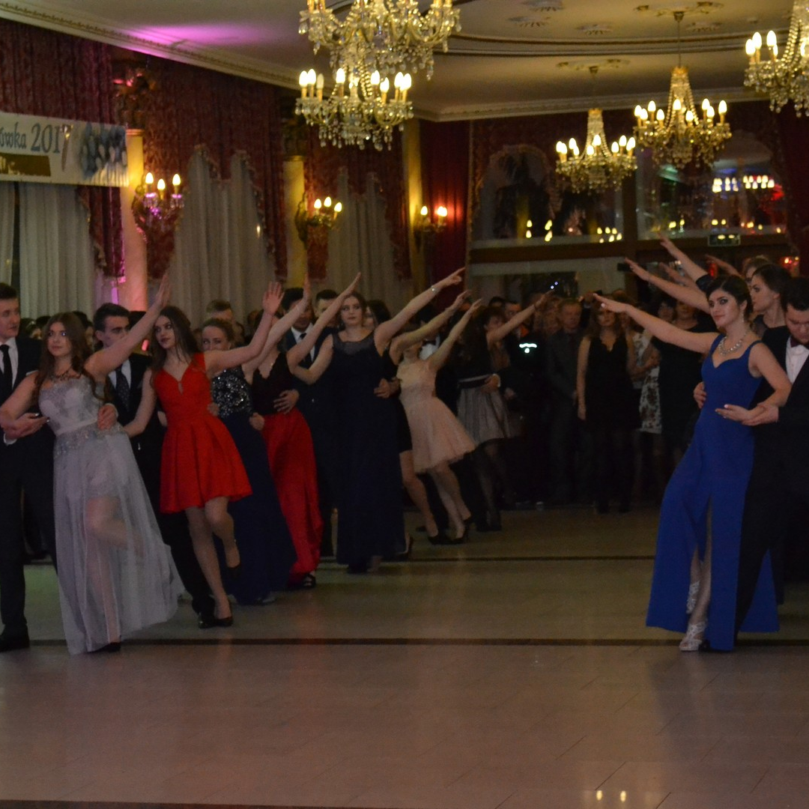
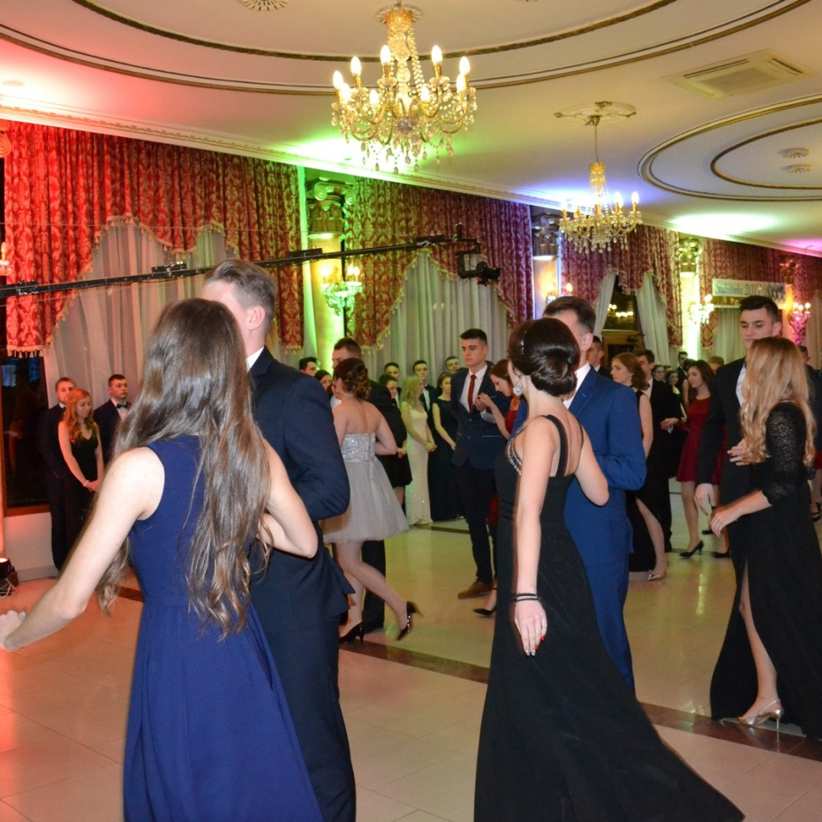
Studniówka (school prom) — senior students go to a ball traditionally one hundred days before final exams.

Slide 6
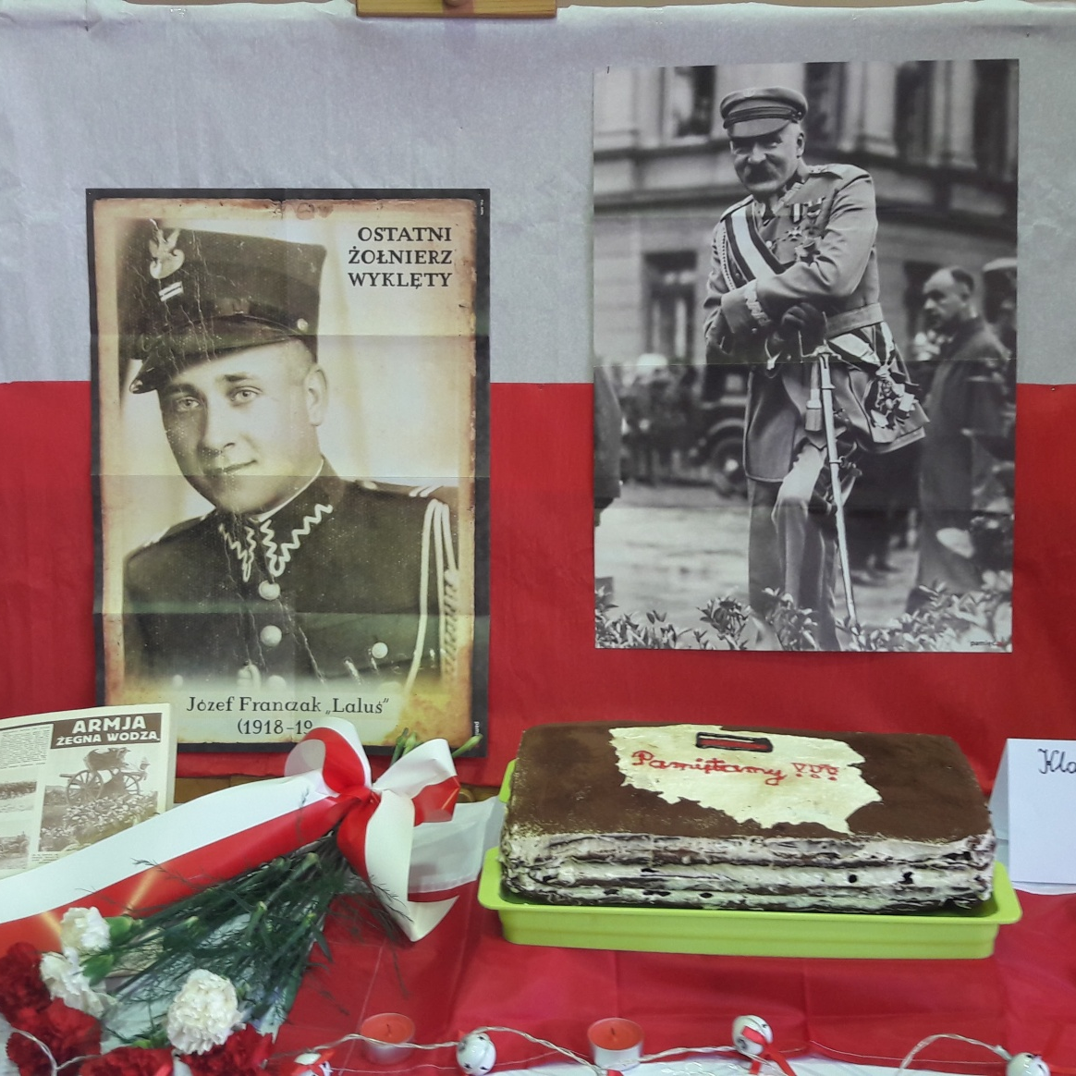
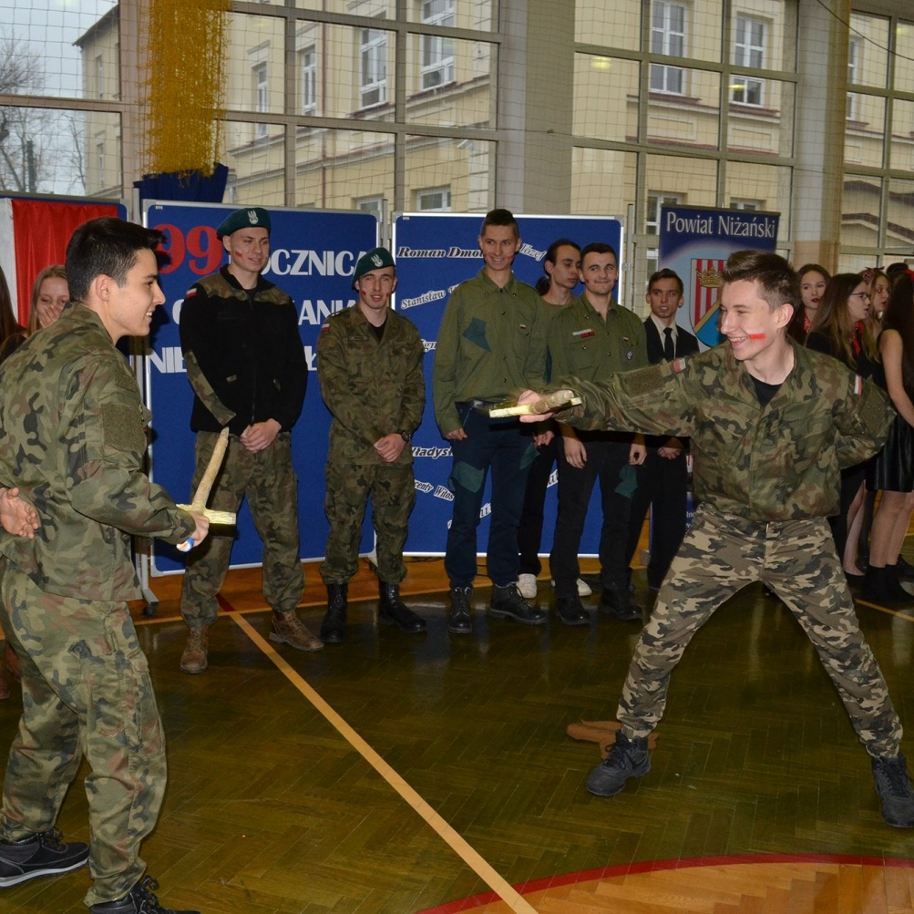
11th November — National Independence Day. We celebrate a joyful festival in our school. We take part in competitions (baking cakes, dressing up as people from the past).

Slide 7
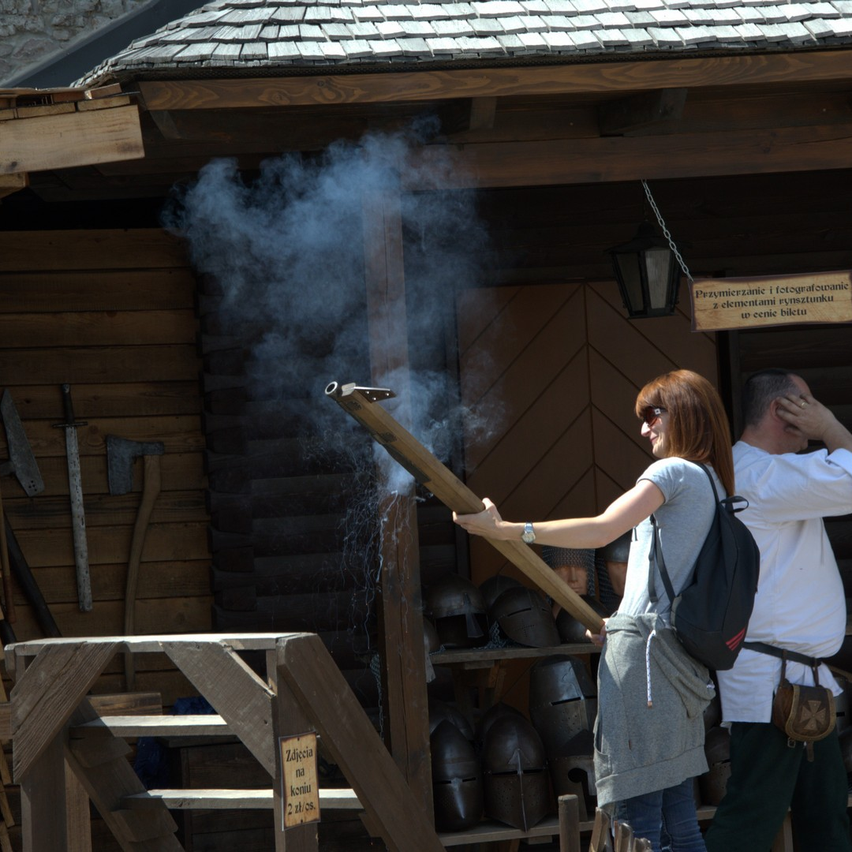
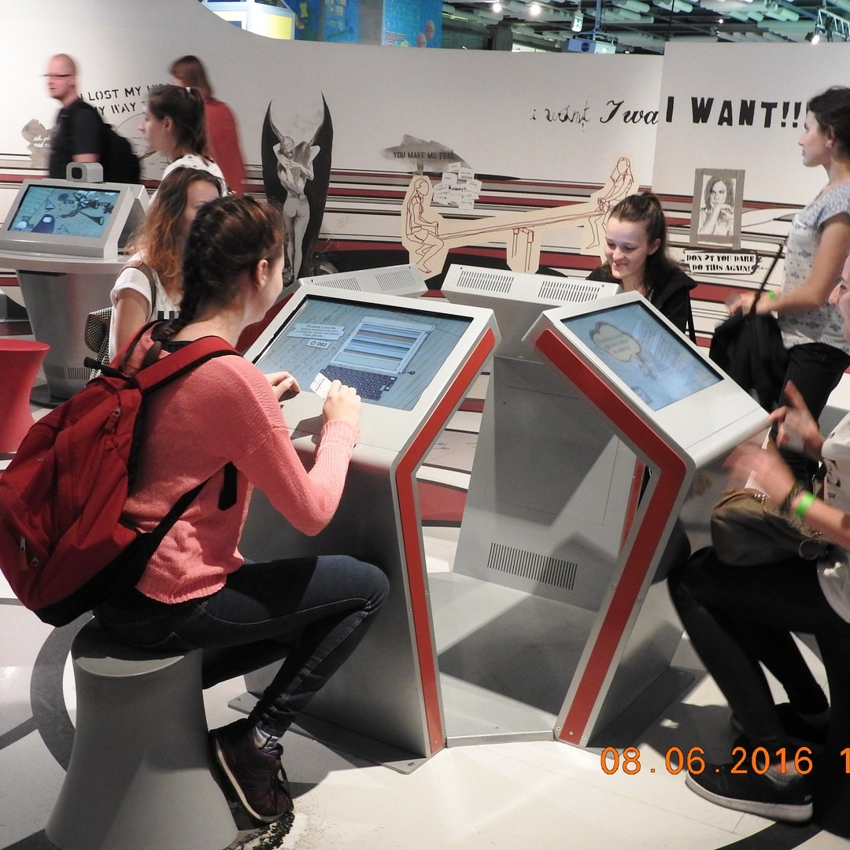
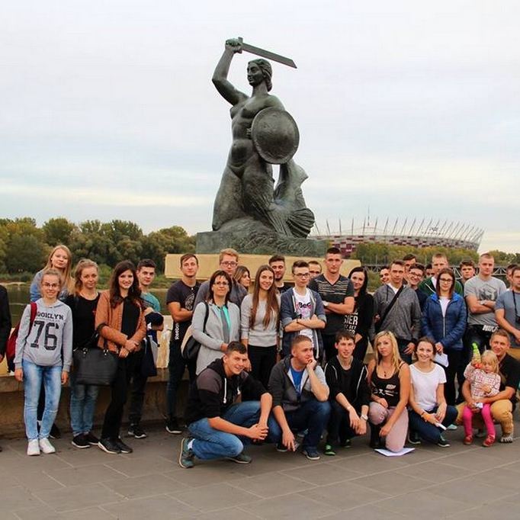
On our school trips we relax, admire beautiful views, visit interesting places and have a good time.

Slide 8
our country - poland

Slide 9
Thecapital of poland - warsaw

Slide 10
the national flag and the national emblem
The national flag consists of two colours, white on the top and red on the bottom.
The white eagle with a golden crown is the national emblem.

Slide 11
the national anthem and polish currency
The Polish ,,Zloty”, literally meaning „golden”, is the currency of Poland. The banknotes in current circulation are 200, 100, 50, 20 and 10 zloty. Coins come in 5, 2, 1 zloty, and 50, 20, 10, 5, 2, 1 groszy units.
Since 1927 „Mazurek Dąbrowskiego” has been the national Polish anthem. The lyrics were originally written in 1797.

Slide 12
polish language
Polish is the official language of Poland. It is used everyday by more than 40 million people in Poland and by up to 8 million Poles living outside the country (mainly in the USA and the UK).
Polish is considered to be one of the more difficult languages to learn by non-native speakers.

Slide 14
Secondary education
Students choose between vocational (technical) schools where they spend four years and specialise in a certain job or general education secondary schools where they spend 3 years and choose a certain type of class (e.g. medical, economics etc) in which they specialise in two or three subjects.
In May graduates from both types of schools take school-leaving national exams called Matura in Polish, Maths, a foreign language and at least one chosen subject which they need to take at the extended level.

